Slide 1


Parallel Processing and Distributed Computing
http://www.datascience4all.org
Introduction to Computational Thinking and Data Science
Yolanda Gil
University of Southern California
gil@isi.edu
CC-BY
Attribution
ACI-1355475
Last Updated:
September 2016

Slide 2
Intended Audience
Designed for students with no programming background who want to have literacy in data and computing to better approach data science projects
Computational thinking: a new way to approach problems through computing
Abstraction, decomposition, modularity,…
Data science: a cross-disciplinary approach to solving data-rich problems
Machine learning, large-scale computing, semantic metadata, workflows,…

Slide 3

These materials are released under a CC-BY License
https://creativecommons.org/licenses/by/2.0/
You are free to:
Share — copy and redistribute the material in any medium or format
Adapt — remix, transform, and build upon the material
for any purpose, even commercially.
The licensor cannot revoke these freedoms as long as you follow the license terms.
Under the following terms:
Attribution — You must give appropriate credit, provide a link to the license,
and indicate if changes were made. You may do so in any reasonable manner,
but not in any way that suggests the licensor endorses you or your use.
Artwork taken from other sources is acknowledged where it appears.
Artwork that is not acknowledged is by the author.
Please credit as: Gil, Yolanda (Ed.) Introduction to Computational Thinking and Data Science. Available from http://www.datascience4all.org
If you use an individual slide, please place the following at the bottom: “Credit: http://www.datascience4all.org/”
As editors of these materials, we welcome your feedback and contributions.

Slide 4
Acknowledgments
ACI-1355475
These course training materials were originally developed and edited by Yolanda Gil (USC) with support from the National Science Foundation with award ACI-1355475
They are made available as part of http://www.datascience4all.org
The course materials benefitted from feedback from many students at USC and student interns, particularly Taylor Alarcon (Brown University), Alyssa Deng (Carnegie Mellon University), and Kate Musen (Swarthmore College)
We welcome new contributions and suggestions

Slide 5
Parallel Processing
Parallel processing
Parallel processing and distributed computing platforms

Slide 6
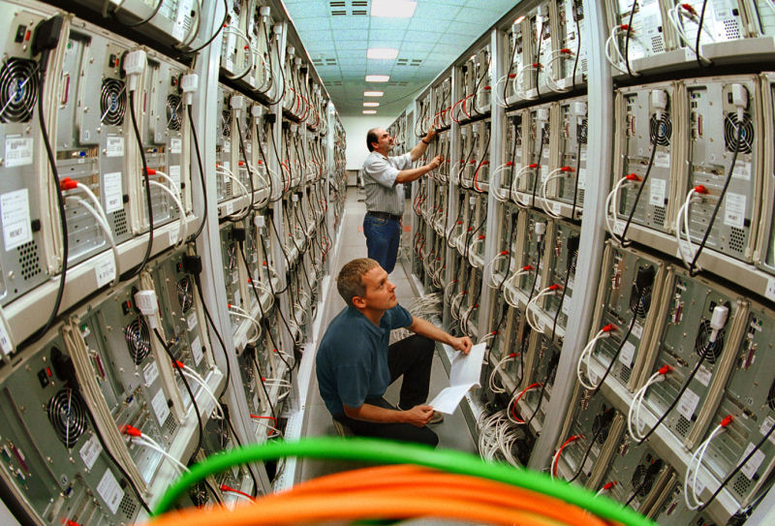
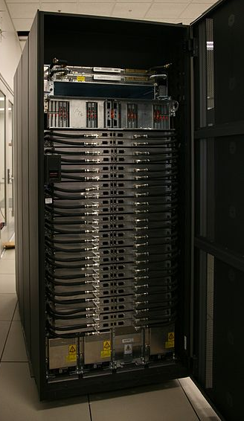
When Datasets Are Large
"MEGWARE.CLIC" by MEGWARE Computer GmbH - http://www.megware.com. Licensed under CC BY-SA 3.0 via Wikimedia Commons –
https://commons.wikimedia.org/wiki/File:MEGWARE.CLIC.jpg#/media/File:MEGWARE.CLIC.jpg
https://commons.wikimedia.org/wiki/File:Blue_Waters_Rack.jpg

Slide 7
Parallel Processing
Estimating execution time
Algorithmic complexity
Processing several datasets with a workflow
Processing data with a divide-and-conquer strategy
Analysis of parallel processing

Slide 8
Estimating Execution Time

Slide 9
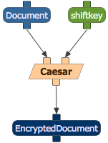
Processing a Document: Encryption Workflow
It was the best of times, it was the worst of times, it was the age of wisdom, it was the age of foolishness, it was the epoch of belief, it was the epoch of incredulity, it was the season of Light, it was the season of Darkness, it was the spring of hope, it was the winter of despair…
shiftkey=1
Ju xbt uif cftu pg ujnft, …

Slide 10
Encryption Workflow: How Does It Work
It was the best of times, it was the worst of times, it was the age of wisdom, it was the age of foolishness, it was the epoch of belief, it was the epoch of incredulity, it was the season of Light, it was the season of Darkness, it was the spring of hope, it was the winter of despair…
shiftkey=1
a
b
c
d
e
f
g
h
i
j
…

Slide 11
Execution Time with Shiftkey=1
time
shiftkey=1
size

Slide 12
Encryption Workflow: How Does It Work
It was the best of times, it was the worst of times, it was the age of wisdom, it was the age of foolishness, it was the epoch of belief, it was the epoch of incredulity, it was the season of Light, it was the season of Darkness, it was the spring of hope, it was the winter of despair…
shiftkey=5
a
b
c
d
e
f
g
h
i
j
…

Slide 13
Execution Time with Different Shiftkey Values
shiftkey=8
time
shiftkey=5
shiftkey=1
time = numletters x shiftkey
size

Slide 14
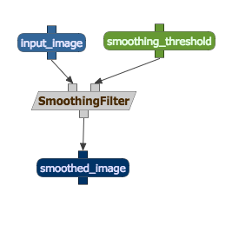
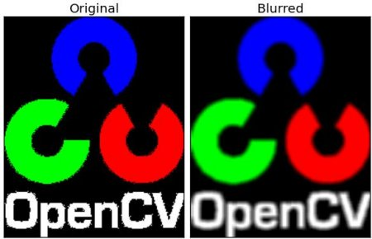
Image Processing Workflow

Slide 15
Execution Time
time
size

Slide 16
Algorithmic Complexity

Slide 17
Algorithmic Complexity
An algorithm has linear complexity when its execution time grows linearly with the size of the input data
An algorithm has polynomial complexity when its execution time is bound by a polynomial expression in the size of the input data (e.g., n³)
Similarly, an algorithm has exponential complexity when bound by an exponential expression (e.g., 2^{n})
time
time
size
size

Slide 18
Algorithmic Complexity: Big “O” Notation
n: size of the input data
Linear complexity
Polynomial complexity
O(n)
O(n^{k})
Exponential complexity
O(k^{n})

Slide 19
Algorithmic Complexity: Examples
O(n)
O(n^{k})
Linear complexity: Processing input data beginning to end without going back
e.g., smoothing each pixel in an image, encoding a document, translating, counting how many words total, etc.
Polynomial complexity: Processing input data (or answer) back and forth
e.g., removing duplicates in a document, tallying how many times each word appears, etc.
O(k^{n})
Exponential complexity: Processing input data over and over to make cross-correspondences
e.g., figuring out if two graphs have the same structure

Slide 20
Processing Several Datasets with a Workflow

Slide 21
What If Workflows Could Use Many Computers to Run Steps?
"MEGWARE.CLIC" by MEGWARE Computer GmbH - http://www.megware.com. Licensed under CC BY-SA 3.0 via Wikimedia Commons –
https://commons.wikimedia.org/wiki/File:MEGWARE.CLIC.jpg#/media/File:MEGWARE.CLIC.jpg

Slide 22
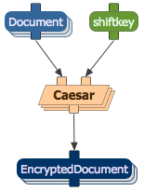
Using the Same Workflow to Process Several Documents
It was the best of times, it was the worst of times, it was the age of wisdom, it was the age of foolishness, it was the epoch of belief, it was the epoch of incredulity, it was the season of Light, it was the season of Darkness, it was the spring of hope, it was the winter of despair…
Four score and seven years ago our fathers brought forth on this continent, a new nation, conceived in Liberty, and dedicated to the proposition that all men are created equal.
We the People of the United States, in Order to form a more perfect Union, establish Justice, insure domestic Tranquility, …

Slide 23
Processing Several Datasets with a Workflow
It was the best of times, it was the worst of times, it was the age of wisdom, it was the age of foolishness, it was the epoch of belief, it was the epoch of incredulity, it was the season of Light, it was the season of Darkness, it was the spring of hope, it was the winter of despair…
We the People of the United States, in Order to form a more perfect Union, establish Justice, insure domestic Tranquility, …
Four score and seven years ago our fathers brought forth on this continent, a new nation, conceived in Liberty, and dedicated to the proposition that all men are created equal.
The workflow on the left represents in compact form that 3 separate workflows will be executed on the right, one for each dataset
It is called a workflow template, and it is expanded automatically by the workflow system into the executable workflows

Slide 24
Processing Data with a Divide-and-Conquer Strategy

Slide 25
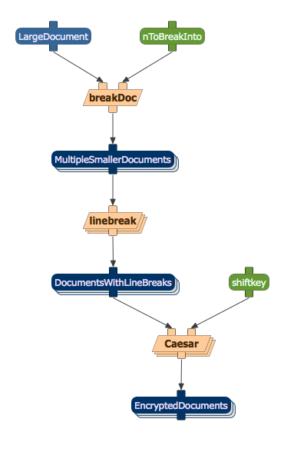
It was the best of times, it was the worst of times, it was the age of wisdom, it was the age of foolishness, it was the epoch of belief, it was the epoch of incredulity, it was the season of Light, it was the season of Darkness, it was the spring of hope, it was the winter of despair…
It was the best of times, it was the worst of times,
it was the age of wisdom, it was the age of foolishness,
it was the epoch of belief, it was the epoch of incredulity,
it was the season of Light, it was the season of Darkness,
it was the spring of hope, it was the winter of despair…

Slide 26
A Divide-and-Conquer Strategy
Divide into pieces
Solve each piece separately
Combine the individual results
Requires that each piece is independent of the others

Slide 27
Parallel Processing of a Dataset as Divide-and-Conquer
Phase 1 Split the data
Phase 2 Process the data
Phase 3
Join the results

Slide 28
Phase 1: Split
It was the best of times, it was the worst of times,
it was the age of wisdom, it was the age of foolishness,
it was the epoch of belief, it was the epoch of incredulity,
it was the season of Light, it was the season of Darkness,
it was the spring of hope, it was the winter of despair…
Target = 5
Split
It was the best of times, it was the worst of times,
it was the age of wisdom, it was the age of foolishness,
it was the epoch of belief, it was the epoch of incredulity,
it was the season of Light, it was the season of Darkness,
it was the spring of hope, it was the winter of despair…

Slide 29
Phase 2: Process in Parallel
It was the best of times, it was the worst of times,
it was the age of wisdom, it was the age of foolishness,
it was the epoch of belief, it was the epoch of incredulity,
it was the season of Light, it was the season of Darkness,
it was the spring of hope, it was the winter of despair…

Slide 30
Phase 3: Join
Join

Slide 31
Phase 1: Split
Target = 9
Split

Slide 32
Phase 2: Process in Parallel

Slide 33
Phase 3: Join
Join

Slide 34
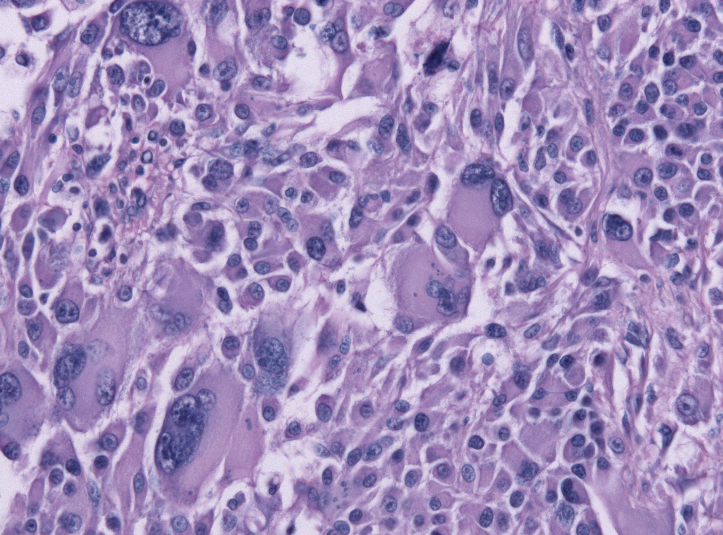
A Divide-and-Conquer Strategy Is Not Always Appropriate
https://commons.wikimedia.org/wiki/File:Giant_cell_glioblastoma_HE_X200.jpg

Slide 35
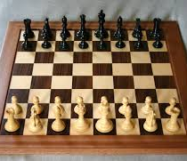
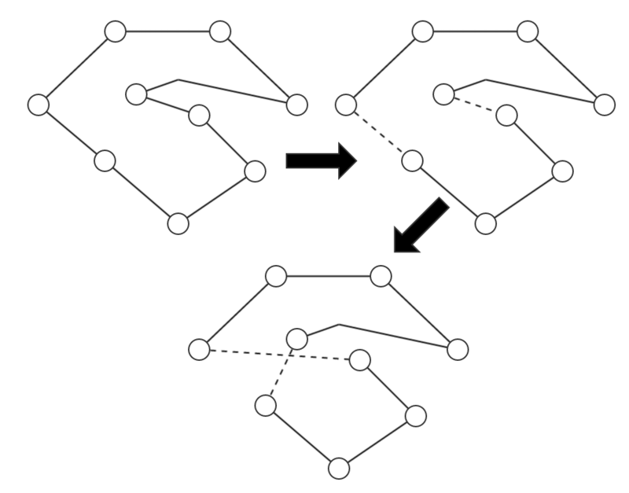
Dependencies and Message Passing
The steps within an algorithm may have significant interdependencies and require exchanging information, and may not be easily parallelizable
https://en.wikipedia.org/wiki/Outline_of_chess
https://en.wikipedia.org/wiki/Travelling_salesman_problem#/media/File:Showing_a_step_of_the_two-opt_heuristic.png

Slide 36
Analysis of Parallel Processing

Slide 37
Analysis of Parallel Processing
Speedup with parallel processing
Critical path
Amdahl’s law
Embarrassingly parallel computations
"MEGWARE.CLIC" by MEGWARE Computer GmbH - http://www.megware.com. Licensed under CC BY-SA 3.0 via Wikimedia Commons –
https://commons.wikimedia.org/wiki/File:MEGWARE.CLIC.jpg#/media/File:MEGWARE.CLIC.jpg

Slide 38
Speedup with Parallel Processing
S = 2x
S= 10x
S=100x
TimeSequential
S =
TimeParallel

Slide 39
Critical Path
A critical path in a computation consists of consecutive steps that are interdependent and therefore not parallelizable

Slide 40
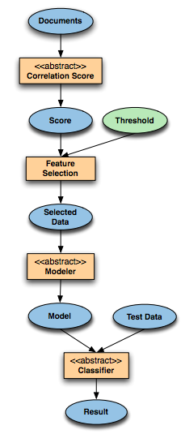
Limitations Imposed by Critical Paths
t/2
Parallelizable
t/2
Critical path

Slide 41
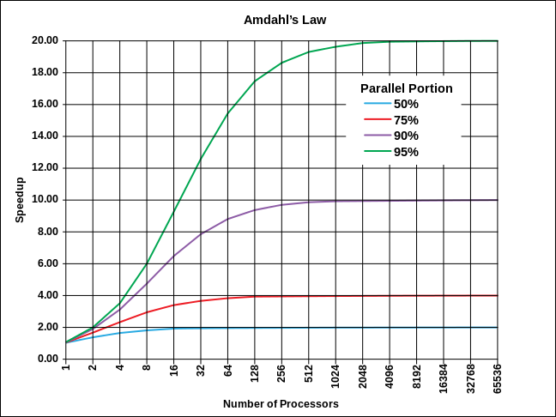
Amdahl’s Law
The theoretical speedup in the execution of a task where
p is the percent (proportion) of the task that is parallelizable is
1
____
1-p
"AmdahlsLaw" by Daniels220 at English Wikipedia - Own work based on: File:AmdahlsLaw.png. Licensed under CC BY-SA 3.0 via Wikimedia Commons –
https://commons.wikimedia.org/wiki/File:AmdahlsLaw.svg#/media/File:AmdahlsLaw.svg

Slide 42
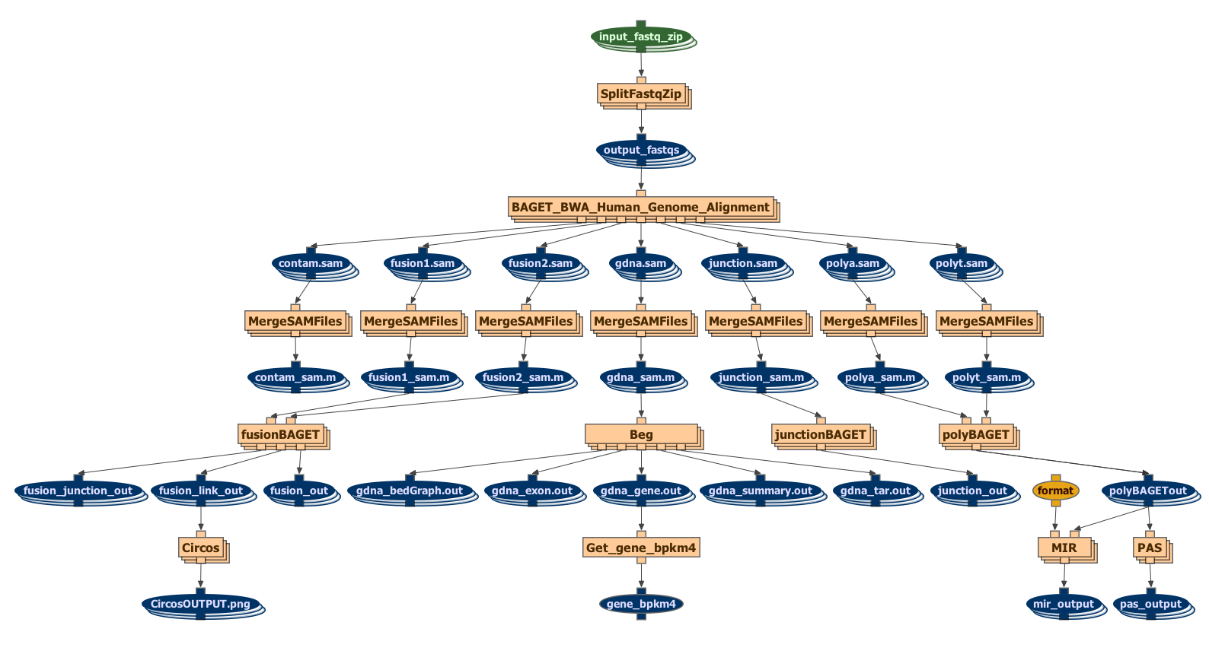
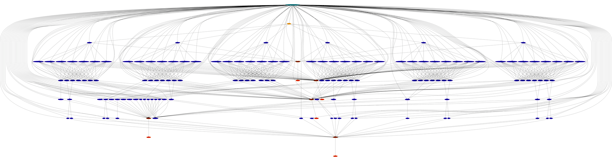
Embarrassingly Parallel Computations
Embarrassingly parallel tasks are cleanly separable and can be carried out in parallel, typically with significant speedups

Slide 43
Analysis of Parallel Processing
Speedup with parallel processing
Critical path
Amdahl’s law
Embarrassingly parallel computations
"MEGWARE.CLIC" by MEGWARE Computer GmbH - http://www.megware.com. Licensed under CC BY-SA 3.0 via Wikimedia Commons –
https://commons.wikimedia.org/wiki/File:MEGWARE.CLIC.jpg#/media/File:MEGWARE.CLIC.jpg

Slide 44
Parallel Processing
Estimating execution time
Algorithmic complexity
Processing several datasets with a workflow
Processing data with a divide-and-conquer strategy
Analysis of parallel processing

Slide 45
Parallel and Distributed Computing Platforms
Introduction to Computational Thinking and Data Science
Lecture 15
Yolanda Gil
gil@isi.edu
Fall 2016

Slide 46
Parallel and Distributed Computing Platforms
Multi-core computing
Supercomputers
Distributed computation
Cloud computing
Practical aspects of distributed computing
Parallel programming
Distributed computing @ USC

Slide 47
Multi-Core Computing

Slide 48
A Single Processor
Processor
Memory

Slide 49
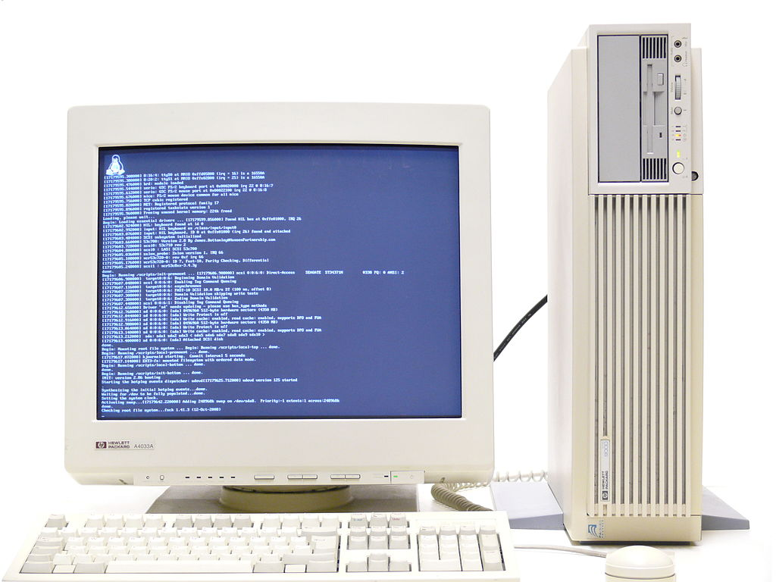
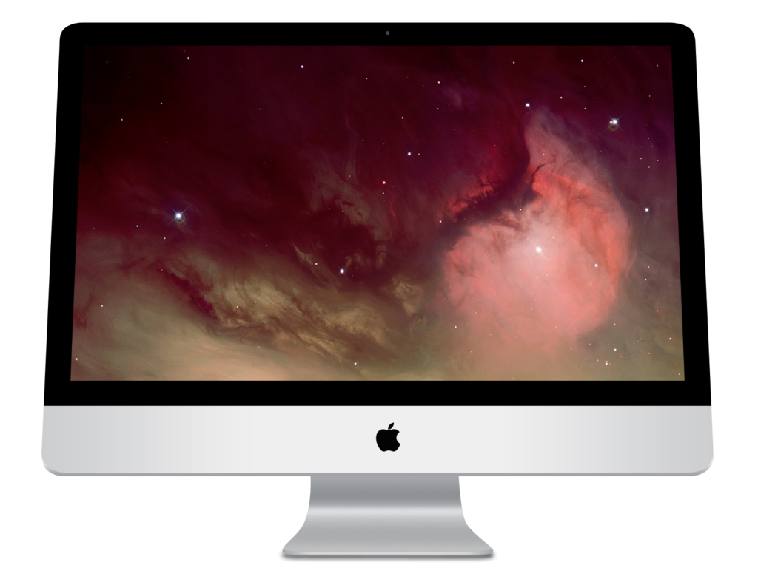
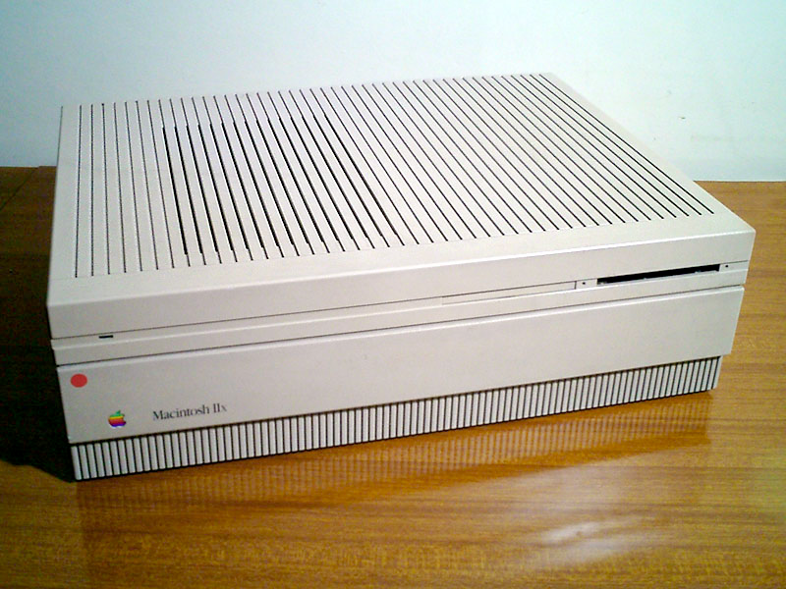

Single Processors
https://pixabay.com/en/user-female-girl-anonymous-person-297566/
https://pixabay.com/en/user-avatar-female-blond-girl-310807/
https://pixabay.com/en/user-man-profile-male-face-gui-33638/
"HP-HP9000-C110-Workstation 21" by Thomas Schanz - Own work. Licensed under CC BY-SA 3.0 via Wikimedia Commons –
https://commons.wikimedia.org/wiki/File:HP-HP9000-C110-Workstation_21.jpg#/media/File:HP-HP9000-C110-Workstation_21.jpg
"Macintosh IIx". Licensed under CC BY-SA 3.0 via Wikimedia Commons - https://commons.wikimedia.org/wiki/File:Macintosh_IIx.jpg#/media/File:Macintosh_IIx.jpg
"Imac 16-9" by Matthieu Riegler, Wikimedia Commons. Licensed under CC BY 3.0 via Wikimedia Commons - https://commons.wikimedia.org/wiki/File:Imac_16-9.png#/media/File:Imac_16-9.png

Slide 50
Multi-Core Computing
Several processors (cores) in the same computer
Processor
Processor
Processor
Processor

Slide 51
Multi-Core Computing: 1) Shared Memory
Processor
Memory
Processor
Processor
Processor

Slide 52
Multi-Core Computing: Shared Memory Example
Processor
Memory
Processor
Calc. Avg
Calc. Max
Processor
Dataset
Processor
Calc. Mean
Calc. Min

Slide 53
Multi-Core Computing: 2) Distributed Memory
Memory
Processor
Processor
Memory
Memory
Processor
Processor
Memory

Slide 54
Multi-Core Computing: Distributed Memory
Memory
Processor
Processor
Memory
Data Q1
Data Q3
Memory
Processor
Processor
Memory
Data Q2
Data Q4

Slide 55
Multi-Core Computing: 3) Mixed-Memory Architecture
Memory
Processor
Processor
Memory
SHARED
MEMORY
Memory
Processor
Processor
Memory

Slide 56
Multi-Core Computing
Memory
Processor
Processor
Memory
Memory
Processor
SHARED
MEMORY
Processor
Memory
Memory
Processor
Processor
Memory
Memory
Processor
Processor
Memory

Slide 57
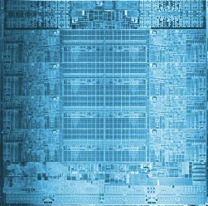
Multi-Core Chips
From [Navarro et al 2014] http://www.global-sci.com/openaccess/v15_285.pdf

Slide 58
Multi-Core Chips
From [Navarro et al 2014] http://www.global-sci.com/openaccess/v15_285.pdf

Slide 59
Multi-Core Chips
From [Navarro et al 2014] http://www.global-sci.com/openaccess/v15_285.pdf

Slide 60
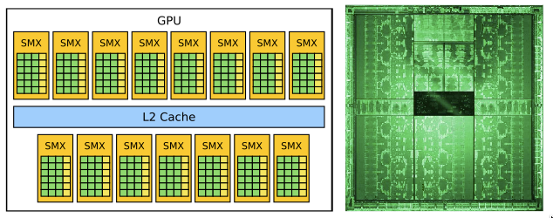
Graphical Processing Units (GPUs)
Graphical processing units (GPUs) are designed to do simple computations to display graphics and are very cheap
They turn out to be very useful to do simple computations in parallel
Nvidia’s Tesla K20X GPU
From [Navarro et al 2014] http://www.global-sci.com/openaccess/v15_285.pdf

Slide 61
Supercomputers

Slide 62
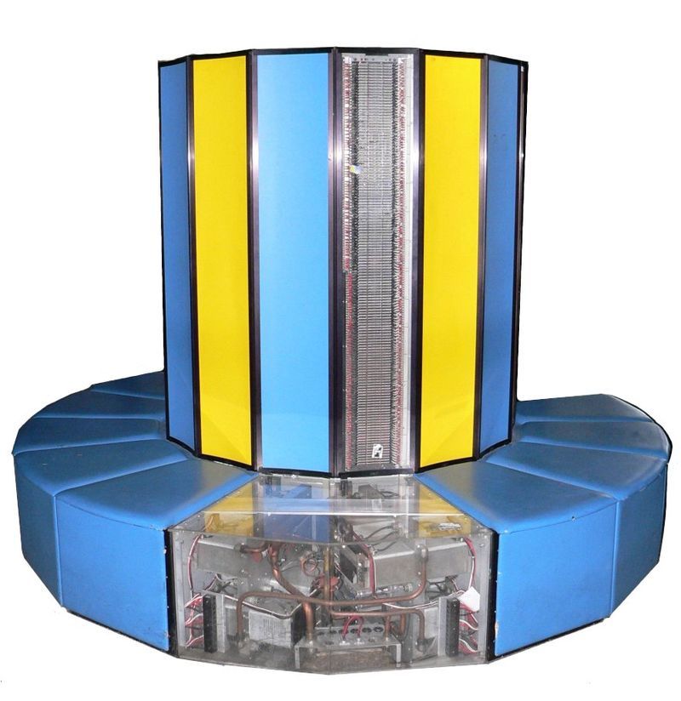
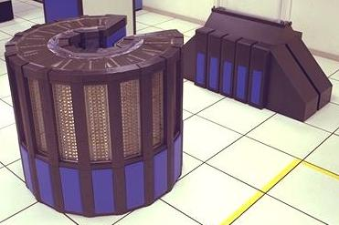
Supercomputers in the 1980s
Cray X-MP @ EPFL (1982)
Cray-2 @ NASA (1985)
"Cray2" by NASA - http://gimp-savvy.com/cgi-bin/img.cgi?ailswE7kkmL1216740. Licensed under Public Domain via Wikimedia Commons –
https://commons.wikimedia.org/wiki/File:Cray2.jpeg#/media/File:Cray2.jpeg
"EPFL CRAY-I 1 clean" by Rama - Own work. Licensed under CC BY-SA 2.0 fr via Wikimedia Commons –
https://commons.wikimedia.org/wiki/File:EPFL_CRAY-I_1_clean.jpg#/media/File:EPFL_CRAY-I_1_clean.jpg
https://www.youtube.com/watch?v=atIKUEfW-Vw
Notes:
Cray X-MP: 400 MFLOPS peak performance

Slide 63
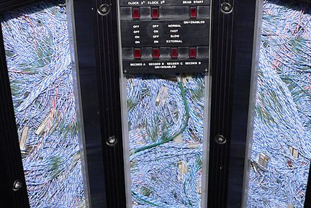
https://en.wikipedia.org/wiki/Cray-2#/media/File:EPFL_CRAY-II_2.jpg

Slide 64
Floating Point Operations per Second (FLOPS)
Name Abbreviation FLOPS
kiloFLOPS kFLOPS 10³
megaFLOPS MFLOPS 10⁶
gigaFLOPS GFLOPS 10⁹
teraFLOPS TFLOPS 10¹²
petaFLOPS PFLOPS 10¹⁵
exaFLOPS EFLOPS 10¹⁸
zettaFLOPS ZFLOPS 10²¹
yottaFLOPS YFLOPS 10²⁴

Slide 65
Supercomputers in the 1980s
Cray X-MP (1982)
400 MFLOPS
Cray-2 (1985)
1.59 GFLOPS
"Cray2" by NASA - http://gimp-savvy.com/cgi-bin/img.cgi?ailswE7kkmL1216740. Licensed under Public Domain via Wikimedia Commons –
https://commons.wikimedia.org/wiki/File:Cray2.jpeg#/media/File:Cray2.jpeg
"EPFL CRAY-I 1 clean" by Rama - Own work. Licensed under CC BY-SA 2.0 fr via Wikimedia Commons –
https://commons.wikimedia.org/wiki/File:EPFL_CRAY-I_1_clean.jpg#/media/File:EPFL_CRAY-I_1_clean.jpg
Notes:
Cray X-MP: 400 MFLOPS peak performance
From https://en.wikipedia.org/wiki/Cray-2#Comparison_to_later_computers:
“In 2012, Piotr Luszczek (a former doctoral student of Jack Dongarra), presented results showing that an iPad 2 matched the historical performance of the Cray-2 on an embedded LINPACK benchmark.^{[1]”}

Slide 66
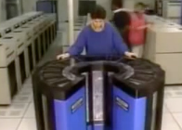
Supercomputers in the 1980s
Cray-2 @ NASA (1985)
1.59 GFLOPS
"Cray2" by NASA - http://gimp-savvy.com/cgi-bin/img.cgi?ailswE7kkmL1216740. Licensed under Public Domain via Wikimedia Commons –
https://commons.wikimedia.org/wiki/File:Cray2.jpeg#/media/File:Cray2.jpeg
"EPFL CRAY-I 1 clean" by Rama - Own work. Licensed under CC BY-SA 2.0 fr via Wikimedia Commons –
https://commons.wikimedia.org/wiki/File:EPFL_CRAY-I_1_clean.jpg#/media/File:EPFL_CRAY-I_1_clean.jpg
Notes:
Cray X-MP: 400 MFLOPS peak performance
From https://en.wikipedia.org/wiki/Cray-2#Comparison_to_later_computers:
“In 2012, Piotr Luszczek (a former doctoral student of Jack Dongarra), presented results showing that an iPad 2 matched the historical performance of the Cray-2 on an embedded LINPACK benchmark.^{[1]”}

Slide 67
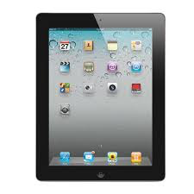
Supercomputers in the 1980s
Cray-2 @ NASA (1985)
1.59 GFLOPS
"Cray2" by NASA - http://gimp-savvy.com/cgi-bin/img.cgi?ailswE7kkmL1216740. Licensed under Public Domain via Wikimedia Commons –
https://commons.wikimedia.org/wiki/File:Cray2.jpeg#/media/File:Cray2.jpeg
"EPFL CRAY-I 1 clean" by Rama - Own work. Licensed under CC BY-SA 2.0 fr via Wikimedia Commons –
https://commons.wikimedia.org/wiki/File:EPFL_CRAY-I_1_clean.jpg#/media/File:EPFL_CRAY-I_1_clean.jpg
Notes:
Cray X-MP: 400 MFLOPS peak performance
From https://en.wikipedia.org/wiki/Cray-2#Comparison_to_later_computers:
“In 2012, Piotr Luszczek (a former doctoral student of Jack Dongarra), presented results showing that an iPad 2 matched the historical performance of the Cray-2 on an embedded LINPACK benchmark.^{[1]”}

Slide 68
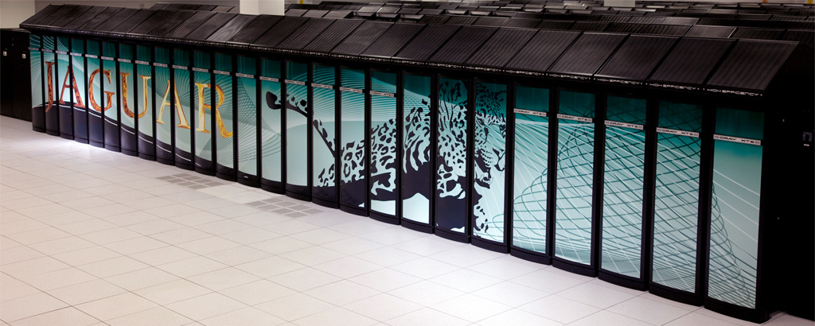
Supercomputers in the New Millenium
Cray XT5 @ ORNL (2005)
1.75 PFLOPS
224,000 cores
Cray XK6 (2011)
50 PFLOPS
https://en.wikipedia.org/wiki/Cray_XT5#/media/File:Jaguar_supercomputer.jpg

Slide 69
Supercomputers Today
Blue Waters @ NCSA (2012)
13.3 petaFLOPS
https://commons.wikimedia.org/wiki/File:Blue_Waters_Rack.jpg

Slide 70
Evolution
Cray X-MP
400 MFLOPS
Name Abbreviation FLOPS
kiloFLOPS kFLOPS 10³
megaFLOPS MFLOPS 10⁶
gigaFLOPS GFLOPS 10⁹
teraFLOPS TFLOPS 10¹²
petaFLOPS PFLOPS 10¹⁵
exaFLOPS EFLOPS 10¹⁸
zettaFLOPS ZFLOPS 10²¹
yottaFLOPS YFLOPS 10²⁴
Mac Intel processor
90 GFLOPS
Nvidia’s Tesla
K20X GPU:
4 TFLOPS
Blue Waters
13.3 petaFLOPS

Slide 71
Distributed Computing

Slide 72
Distributed Computation
Web services
Grid computing
Cluster computing
Cloud computing
Virtual machines

Slide 73
Distributed Computing
Memory
Processor
Processor
Memory
Memory
Processor
Processor
Memory

Slide 74
Distributed Computing
A parallel computing paradigm where individual cores do computations that are orchestrated over a network (eg the Internet)
"HP-HP9000-C110-Workstation 21" by Thomas Schanz - Own work. Licensed under CC BY-SA 3.0 via Wikimedia Commons –
https://commons.wikimedia.org/wiki/File:HP-HP9000-C110-Workstation_21.jpg#/media/File:HP-HP9000-C110-Workstation_21.jpg
"Macintosh IIx". Licensed under CC BY-SA 3.0 via Wikimedia Commons - https://commons.wikimedia.org/wiki/File:Macintosh_IIx.jpg#/media/File:Macintosh_IIx.jpg
"Imac 16-9" by Matthieu Riegler, Wikimedia Commons. Licensed under CC BY 3.0 via Wikimedia Commons - https://commons.wikimedia.org/wiki/File:Imac_16-9.png#/media/File:Imac_16-9.png

Slide 75

Web Services
An approach to distributed computing where third parties offer services for remote execution that can be orchestrated to create complex applications
Give me a book ID and a Paypal
account and I will ship it to you
Give me a Paypal account and
a charge and I will authorize it
Give me a Paypal authorization
and I will transfer funds
Give me a shipping request
and I will set up pick up & delivery
"Internet1" by Rock1997 - Own work. Licensed under GFDL via Wikimedia Commons - https://commons.wikimedia.org/wiki/File:Internet1.jpg#/media/File:Internet1.jpg
https://en.wikipedia.org/wiki/Hypertext_Transfer_Protocol#/media/File:Internet1.jpg
"HP-HP9000-C110-Workstation 21" by Thomas Schanz - Own work. Licensed under CC BY-SA 3.0 via Wikimedia Commons –
https://commons.wikimedia.org/wiki/File:HP-HP9000-C110-Workstation_21.jpg#/media/File:HP-HP9000-C110-Workstation_21.jpg
"Macintosh IIx". Licensed under CC BY-SA 3.0 via Wikimedia Commons - https://commons.wikimedia.org/wiki/File:Macintosh_IIx.jpg#/media/File:Macintosh_IIx.jpg
"Imac 16-9" by Matthieu Riegler, Wikimedia Commons. Licensed under CC BY 3.0 via Wikimedia Commons - https://commons.wikimedia.org/wiki/File:Imac_16-9.png#/media/File:Imac_16-9.png

Slide 76
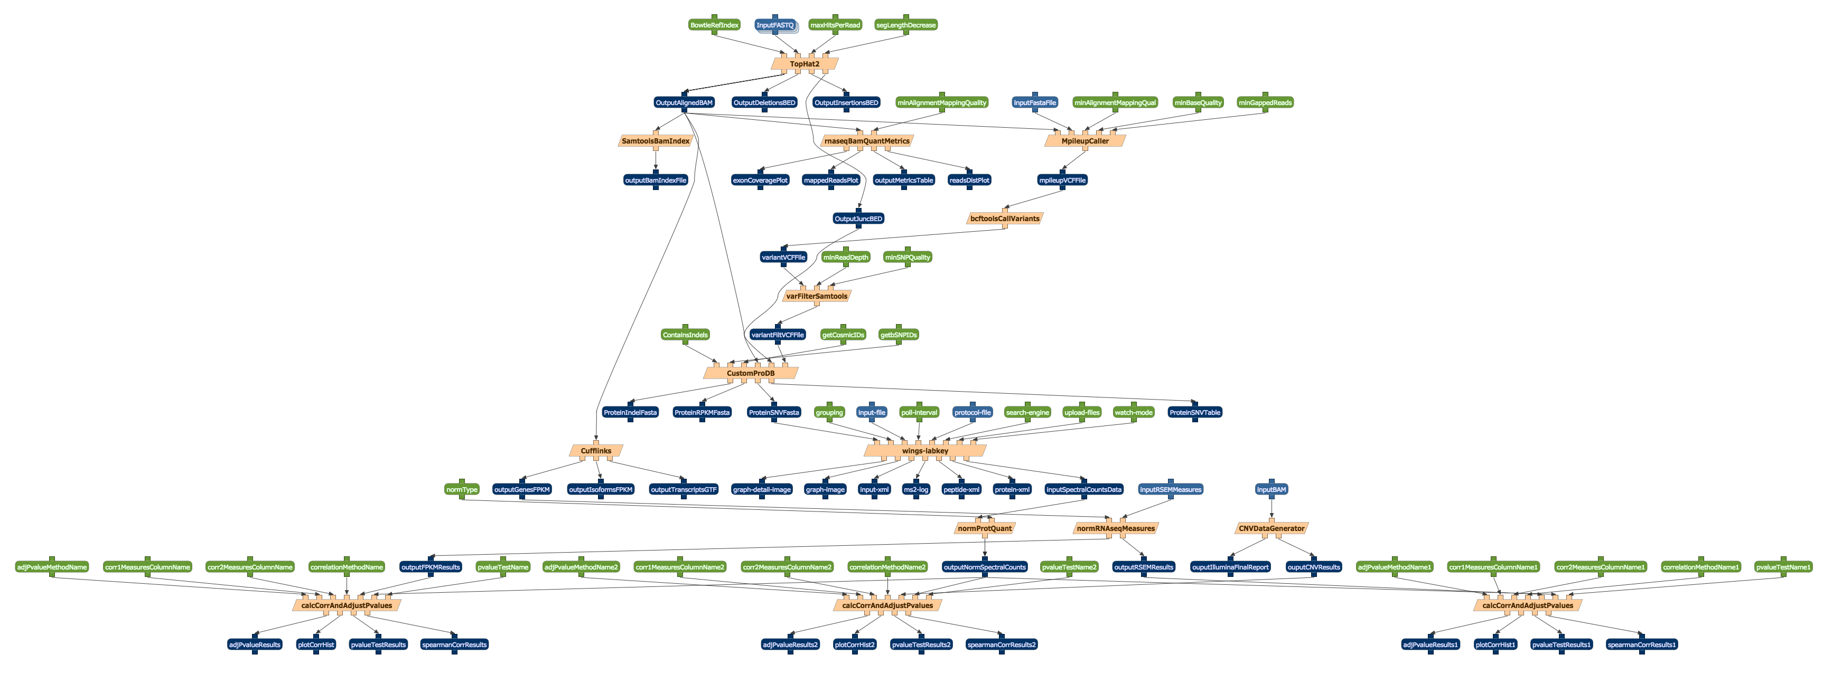



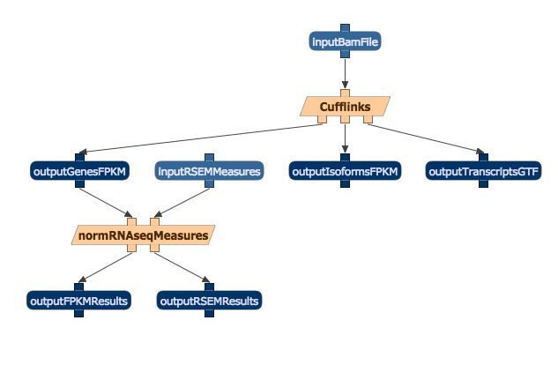
Grid Computing
An approach to distributed computing where the computing power of several computers of different nature are orchestrated through a central “middleware” control center
“Middleware”
https://pixabay.com/en/user-female-girl-anonymous-person-297566/
https://pixabay.com/en/user-avatar-female-blond-girl-310807/
https://pixabay.com/en/user-man-profile-male-face-gui-33638/
"HP-HP9000-C110-Workstation 21" by Thomas Schanz - Own work. Licensed under CC BY-SA 3.0 via Wikimedia Commons –
https://commons.wikimedia.org/wiki/File:HP-HP9000-C110-Workstation_21.jpg#/media/File:HP-HP9000-C110-Workstation_21.jpg
"Macintosh IIx". Licensed under CC BY-SA 3.0 via Wikimedia Commons - https://commons.wikimedia.org/wiki/File:Macintosh_IIx.jpg#/media/File:Macintosh_IIx.jpg
"Imac 16-9" by Matthieu Riegler, Wikimedia Commons. Licensed under CC BY 3.0 via Wikimedia Commons - https://commons.wikimedia.org/wiki/File:Imac_16-9.png#/media/File:Imac_16-9.png

Slide 77
Cluster Computing
An approach to distributed computing where the processing power of several computers of very similar nature is orchestrated through a central head node
"MEGWARE.CLIC" by MEGWARE Computer GmbH - http://www.megware.com. Licensed under CC BY-SA 3.0 via Wikimedia Commons –
https://commons.wikimedia.org/wiki/File:MEGWARE.CLIC.jpg#/media/File:MEGWARE.CLIC.jpg

Slide 78
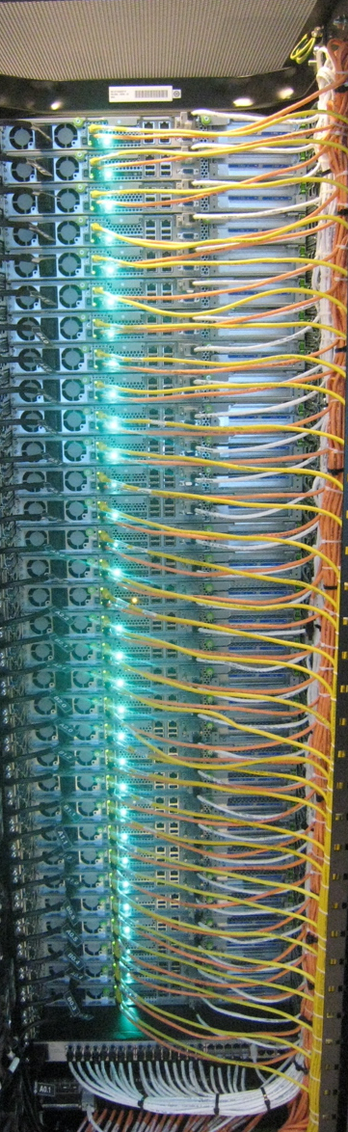
Cluster Computing
Head Node
M
M
M
M
M
M
M
M
M
M
M
M
Memory
https://pixabay.com/en/user-female-girl-anonymous-person-297566/
https://pixabay.com/en/user-avatar-female-blond-girl-310807/
https://pixabay.com/en/user-man-profile-male-face-gui-33638/
https://www.flickr.com/photos/chrisdag/865724585

Slide 79
Cloud Computing

Slide 80
Cloud Computing
Cloud services
Cloud storage
Cloud computing

Slide 81
Cloud Computing
“I would like a 12-node cluster of Macs running OS X with R v3.2.1”

Slide 82


Cloud Computing
“I would like a 12-node cluster of Macs running OS X with R v3.2.1”

Slide 83



Cloud Computing Services
Amazon EC2
Amazon S3
Amazon Simple Storage Service
"AmazonWebservices Logo" by Amazon.com - http://phx.corporate-ir.net/phoenix.zhtml?c=176060&p=irol-logos. Licensed under Public Domain via Wikimedia Commons –
https://commons.wikimedia.org/wiki/File:AmazonWebservices_Logo.svg#/media/File:AmazonWebservices_Logo.svg
"AWS Simple Icons Storage Amazon S3 Bucket with Objects" by Amazon Web Services LLC –
http://aws.typepad.com/aws/2011/12/introducing-aws-simple-icons-for-your-architecture-diagrams.html. Licensed under CC BY-SA 3.0 via Wikimedia Commons –
https://commons.wikimedia.org/wiki/File:AWS_Simple_Icons_Storage_Amazon_S3_Bucket_with_Objects.svg#/media/File:AWS_Simple_Icons_Storage_Amazon_S3_Bucket_with_Objects.svg

Slide 84
Cloud Computing Considerations
Positives
Negatives
No need to purchase computers
No need for space
No need to manage computer hardware or software
Cost of replicating execution environment
Install in the cloud all the resources that all the software uses in an application
Cost of moving data to the cloud in order to be processed

Slide 85
Practical Aspects of Distributed Computing

Slide 86
Virtual Machines
Virtual machines are frozen versions of all the software in a machine that is needed to run an application, including OS, programming language support, libraries, etc.
“I would like a 12-node cluster of Macs running OS X with R v3.2.1,
Java SE 6, WINGS, …”
“I have it all on my laptop and want exactly the same thing…”
“I’ll specify it all as a Virtual Machine (VM)”
“Now give me 12 of those”
VM: OS X with R v3.2.1,
Java SE 6, WINGS, …

Slide 87
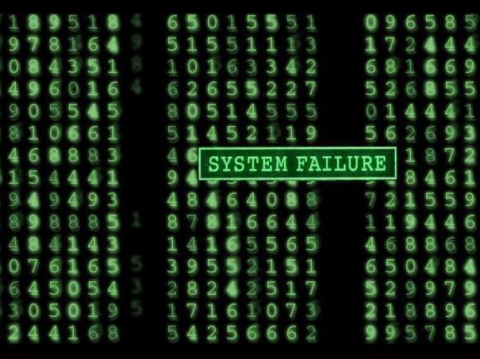
Execution Failures
https://www.flickr.com/photos/51181475@N00/47453849

Slide 88
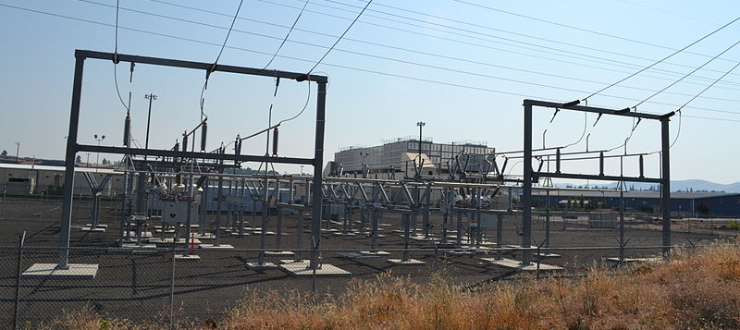
Cooling
https://en.wikipedia.org/wiki/Data_center#/media/File:Google_Data_Center,_The_Dalles.jpg

Slide 89
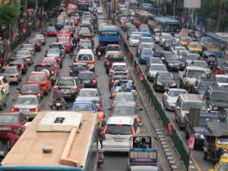
Network Delays
https://commons.wikimedia.org/wiki/File:Bangkok_traffic_by_g-hat.jpg

Slide 90
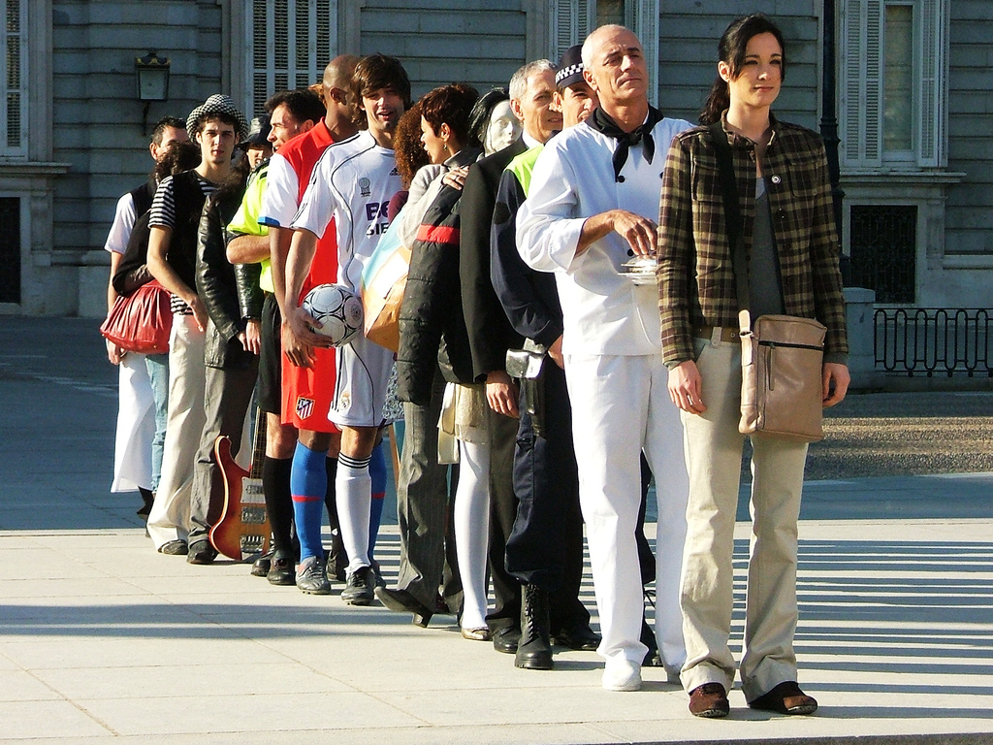
Queuing Delays
https://www.flickr.com/photos/luiscdiaz/330340600

Slide 91
Parallel Programming

Slide 92
Parallel Programming Languages
Languages that contain special instructions to use multiple processing and memory units
RunInParallel [CountWords (Q1, Pr1)
CountWords (Q2, Pr2)
CountWords (Q3, Pr3)
CountWords (Q4, Pr4)]
If {variable ?DoneCounting in SharedMemory} = 4
then {all processors are finished}
Add WordCount variables from (Pr1, Pr2, Pr3, Pr4)
else wait
Data Q1
Data Q3
Data Q2
Data Q4

Slide 93
MapReduce and Hadoop
Provide a programming language to implement a divide-and-conquer paradigm for distributing computations
Split (map)
Process
Join (reduce)
Manage execution failures automatically
MapReduce vs Hadoop
MapReduce was developed at Google and is proprietary
Hadoop has equivalent functionality but is publicly available (open source)
Set up to run on clusters
Hadoop has created an ecosystem of associated software with useful functionality
Spark, Pig, Hive, etc.

Slide 94
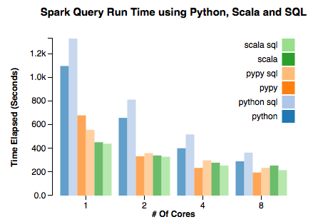
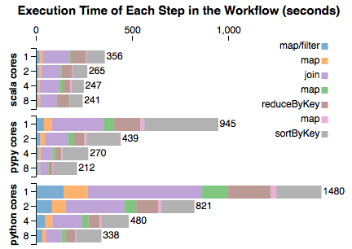
Comparing Parallel Execution Implementations
There is overhead in setting up the parallel jobs
When using few cores, the overhead is more noticeable
http://emptypipes.org/2015/01/17/python-vs-scala-vs-spark/

Slide 95
Distributed Computing @ USC

Slide 96
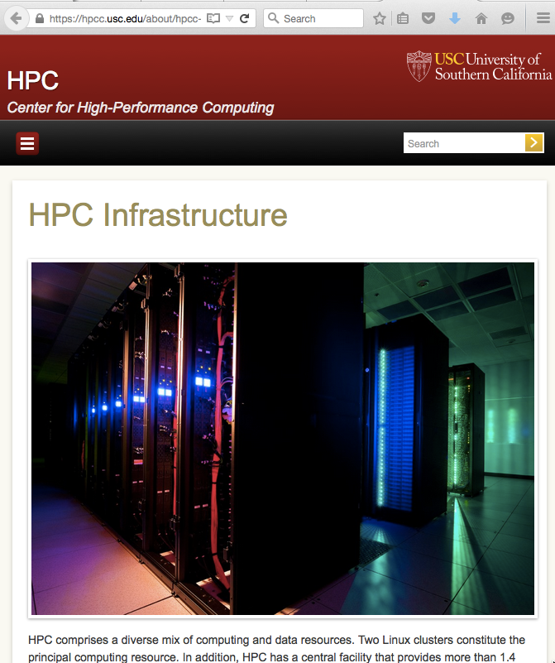
USC Clusters https://hpcc.usc.edu/about/hpcc-infrastructure/
USC HPC’s newest cluster is comprised of 264 Hewlett-Packard SL250, dual Sandy Bridge Xeon 8-core 2.6 gigahertz, dual-processor, dual NVIDIA K20 GPUs containing 2,496 cores each, with 64 gigabytes of memory, 208 Hewlett-Packard SL230, dual Sandy Bridge Xeon 8-core 2.6 gigahertz dual-processor CPUs with 64 gigabytes of memory, 18 Lenovo nx360m5 2.6 gigahertz dual-processor, dual NVIDIA K40 GPUs containing 2,880 cores each with 64 gigabytes of memory, and 5 Lenovo nx360m5 2.6 gigahertz dual-processor, dual NVIDIA K80 GPUs containing 2 x 2,496 cores each with 64 gigabytes of memory. This achieved a benchmark of 555.7 teraflops.
HPC’s other 1,981-node, 4-core, 6-core, and 12-core dual-processor cluster contains Dell, Oracle Sun, Hewlett-Packard, and IBM compute nodes on a 10-gigabit Myrinet backbone and includes 4 large-memory nodes with 1 terabyte of RAM and 4 10-core Intel Xeon processors

Slide 97
Distributed Computing @ USC
March 2016
June 2015
USC HPC’s newest cluster is comprised of 264 Hewlett-Packard SL250, dual Sandy Bridge Xeon 8-core 2.4 gigahertz, dual-processor, dual NVIDIA K20 GPUs containing 2,496 cores each, with 64 gigabytes of memory and 208 Hewlett-Packard SL230, dual Sandy Bridge Xeon 8-core 2.4 gigahertz dual-processor CPUs with 128 gigabytes of memory on an 56.6 FDR Infiniband backbone. This cluster achieved a benchmark of 531.6 teraflops.
USC HPC’s other 2,225-node, 4-core, 6-core, and 12-core dual-processor cluster contains Dell, Oracle Sun, Hewlett-Packard, and IBM compute nodes on a 10-gigabit Myrinet backbone and includes 4 large-memory nodes with 1 terabyte of RAM and 4 10-core Intel Xeon processors.
USC HPC’s newest cluster is comprised of 264 Hewlett-Packard SL250, dual Sandy Bridge Xeon 8-core 2.6 gigahertz, dual-processor, dual NVIDIA K20 GPUs containing 2,496 cores each, with 64 gigabytes of memory, 208 Hewlett-Packard SL230, dual Sandy Bridge Xeon 8-core 2.6 gigahertz dual-processor CPUs with 64 gigabytes of memory, 18 Lenovo nx360m5 2.6 gigahertz dual-processor, dual NVIDIA K40 GPUs containing 2,880 cores each with 64 gigabytes of memory, and 5 Lenovo nx360m5 2.6 gigahertz dual-processor, dual NVIDIA K80 GPUs containing 2 x 2,496 cores each with 64 gigabytes of memory. This achieved a benchmark of 555.7 teraflops.
HPC’s other 1,981-node, 4-core, 6-core, and 12-core dual-processor cluster contains Dell, Oracle Sun, Hewlett-Packard, and IBM compute nodes on a 10-gigabit Myrinet backbone and includes 4 large-memory nodes with 1 terabyte of RAM and 4 10-core Intel Xeon processors.

Slide 98
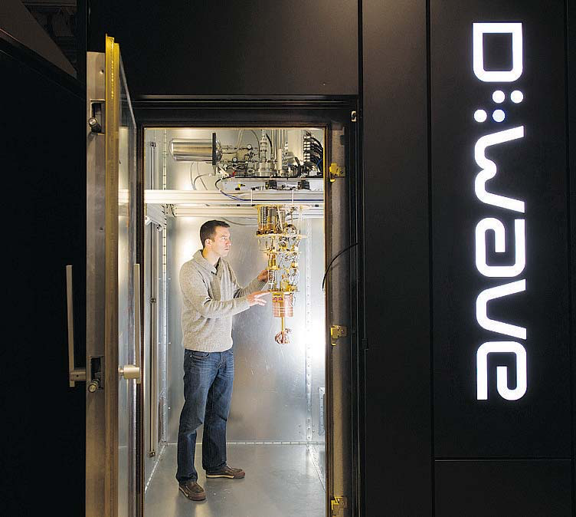
Quantum Computation Center @ USC http://www.isi.edu/research_groups/quantum_computing/
Photograph by: Gerry Kahrmann, PNG Files , Vancouver Sun: http://www.vancouversun.com/technology/burnaby+quantum+computer+maker+wave+pulls+million+funding/10770082/story.html?__lsa=57c7-d780

Slide 99
Parallel and Distributed Computing Platforms
Multi-core computing
Supercomputers
Distributed computation
Cloud computing
Practical aspects of distributed computing
Parallel programming
Distributed computing @ USC

Slide 100
Parallel Processing
Parallel processing
Parallel processing and distributed computing platforms

